Slide 1
Audit of Externally Referred Tests September 2019
Dr Sabrina Mosaheb, Dr Nikola Costa and Dawn Grenshaw

Slide 2
Part 1: About your laboratory
Questionnaire sent out to members of the TAG mailing list in the Southern and Eastern Regions.
19 responses received.
Type of Hospital:
DGH: 12
Teaching hospital: 5
1 teaching hospital and DGH
1 teaching and specialist hospital
Specialist: 3

Slide 3
Part 1: About your laboratory
Network status:
Part of a network: 12
Not part of a network: 7
If part of a network, response is on behalf of:
Your site only: 6
All sites within network: 7
4 sites (1 hub, 3 satellites)
3 sites (x2)
2 sites
1 teaching hospital and 2 x DGHs.

Slide 4
Part 3
Selection of Referral Laboratories

Slide 5
Q1: How many different tests in total does your laboratory have in its test directory that are sent away to other laboratories?

Slide 6
Q2: What are the five most commonly requested externally referred tests in descending order of frequency?
1st place test:
6-thioguanine nucleotides (3 labs)
P3NP (2 labs)
Faecal calprotectin (2 labs)
Vitamins A/E
Serum free light chains
FT3
Copper and caeruloplasmin
Cytogenetic Studies
Tacrolimus
Foetal anomaly screening
Protein electrophoresis
Faecal elastase
Infliximab Serology
Zinc
Downs Antenatal screening
ELF

Slide 7
Q2: What are the five most commonly requested externally referred tests in descending order of frequency?

Slide 8
Q3: Do you have a written policy for selecting referral laboratories?
1 lab: draft written, awaiting approval

Slide 9
Q4: Please state the process for adopting a new externally referred test in your laboratory.
3 labs submitted protocols.
Main themes in responses:
UKAS accreditation checked and confirmed (4 labs)
Cost (including transportation) (4 labs)
Change control document completed (4 labs)
Competency/quality performance (3 labs)
EQA participation and performance (3 labs)
Turnaround Time (3 labs)
Method of testing (3 labs)
Decision signed off by management team (3 labs)
Meeting ISO 15189 requirements (2 labs)
Decision made in conjunction with users (2 labs)
Clinical advice and interpretation (2 labs)
No documented/formal process to follow (2 labs)

Slide 10
Q5: How do you find potential referral labs for a new externally referred test?
Other:
Discussions with colleagues
Email external labs directly
Search on UKAS website for accredited assays

Slide 11
Q6: Do you send samples to any external lab for an assay that is not UKAS-accredited?

Slide 12
Q7: If you send samples to a non-UKAS-accredited lab for an assay and there is an alternative accredited lab for the assay available, do you formally ratify/justify that decision?

Slide 13
Q7: If you send samples to a non-UKAS-accrediated lab for an assay and there is an alternative accredited lab for the assay available, do you formally ratify/justify that decision?
Comments:
Sometimes the only available provider.
Contacted lab to ensure no concerns regarding service.
Documented in change control.
Not formal but considerations would be cost, transport, pre-existing knowledge/experience of a referral lab and clinical staff overseeing assay.
Discussed at clinical conference call. Does the lab meet service requirements and working towards accreditation? Reviewed at least annually.
We justify selection of these labs based on multiple factors: good long-term relationship with lab, appreciation of their expertise/experience of the assay.
If it is part of a local care pathway or SAS laboratory - e.g. certain bone markers
Discussed at clinical governance meetings and formally minuted.

Slide 14
Q8: How often does your laboratory review your repertoire of externally referred tests and your choice of external laboratories.

Slide 15
Q9: If you had more than one option for an external laboratory to perform a test which is requested regularly, how would you rank the following criteria in importance for helping you decide which lab to use?
 | Question | Mean rank
1 | Is the referral lab UKAS accredited? | 2.37
2 | Is the turnaround time acceptable to our users? | 4.44
3 | Are sample requirements feasible for our patients? | 5.44
4 | Do we currently send tests to this laboratory? Are we satisfied with their service? | 6.61
5 | Is the test cost reasonable and competitive? | 6.78
6 | Are sample transport requirements acceptable? | 7.17
7 | Is the lab's EQA appropriate & performance satisfactory? | 7.22
8 | Is there an established clinical pathway in place between our hospital and the referral hospital, which will enable optimal collaboration between clinicians and specialists involved in the care of the patient? | 7.47
9 | Are the geographical location and/or transport links to the referral laboratory convenient? | 8.39
10 | Is the external lab easy to contact to obtain results or clinical advice? | 8.67
11 | Is the laboratory a National or Regional referral centre or centre of excellence? | 9.72
12 | Is the reporting style (including interpretative comments) acceptable? | 9.88
13 | Is the clinical feedback acceptable? (i.e do our users recommend the provider?) | 10.78
14 | Is the reporting method acceptable? (i.e. post, e-mail, fax, NPEx, etc.) | 11.06
15 | Does the referral lab use NPEx? | 13.12

Slide 16
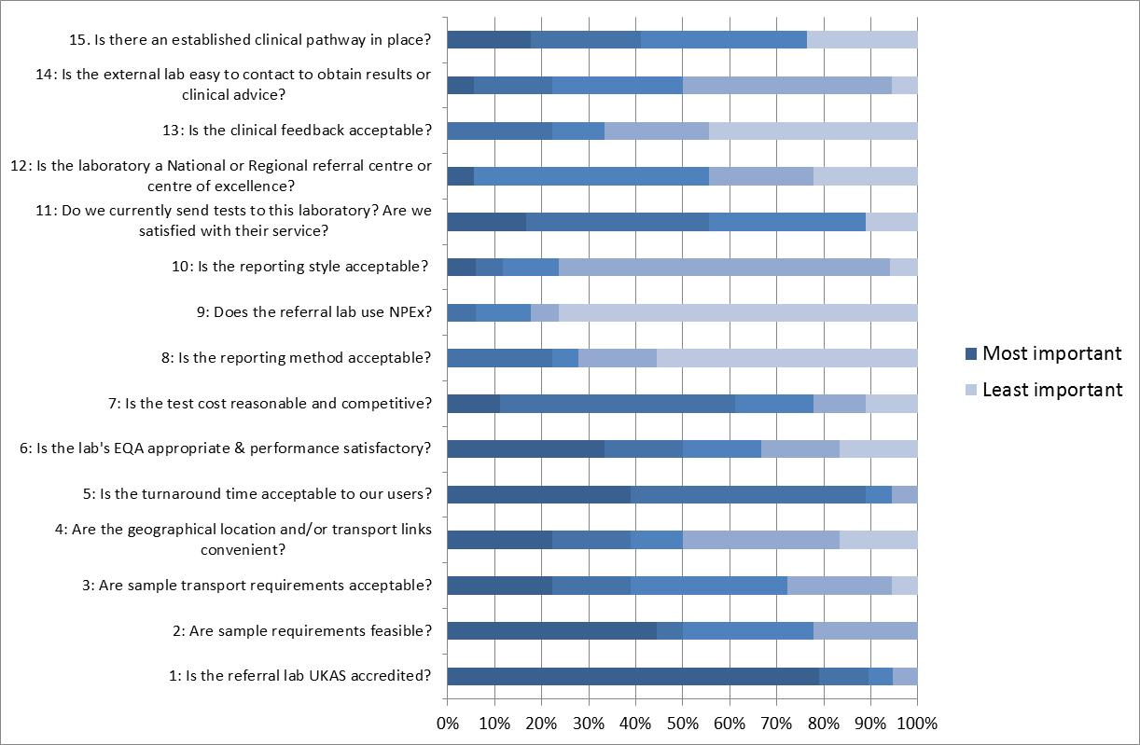

Slide 17
Part 4
Operation of Section for Externally Referred Tests

Slide 18
Q10: Please indicate in which area of your laboratory externally referred tests are handled.

Slide 19
Q11: From which disciplines does your externally referred section handle samples?

Slide 20
Q11: From which disciplines does your externally referred section handle samples?

Slide 21
Q12: If your lab is part of a network, is your externally referred section consolidated onto one site?
Notes:
One lab: future plans to consolidate

Slide 22
Q13: Do you send externally referred samples away in batches?
Yes – 14 labs
No- 4 labs
Non-urgent samples grouped by referral lab and sent together (3 labs)
Daily batches – (3 labs)
Frozen samples batched ( 3 labs)
London transport Tues and Thurs (1 lab)
Sent once a week unless urgent (1 lab)
1st class post 3 x a week plus weekly courier.

Slide 23
Q14: What forms of transport do you use for externally referred samples?

Slide 24
Q15: How does your laboratory send samples that must remain frozen?
-PDQ – specialist ice truck
-When samples sent internationally
Bio-freeze bottles. Contain special coolant to keep sample frozen for 44-48h

Slide 25
Q16: How often does your laboratory send routine frozen samples to external labs?

Slide 26
Q17: What packaging do you use to send frozen samples to external labs?
16 labs: polystyrene boxes
9 labs with dry ice
7 labs with ice packs
2 labs: cardboard boxes with absorbent packaging.
1 lab: UN3373 waterproof bags with ice blocks.
1 lab: containers stored at -40 degrees
6 labs: also put samples in specimen bags
4 labs: UN3373 tape/label
3 labs: absorbent packaging

Slide 27
Q17: What packaging do you use to send unfrozen samples to external labs?
14 labs: cardboard boxes with absorbent packaging.
3 labs: UN3373 boxes
1 lab: complete category B samples transport system from Alpha labs.
1 lab: special moulded plastic container in a padded envelope
7 labs: also put samples in specimen bag
5 labs: UN3373 tape/label

Slide 28
Q18: Please indicate which staff groups are responsible for each aspect of the service

Slide 29
Q19: Approx how many samples does your lab send away each working day?

Slide 30
Q20: How many members of staff (W.T.E) work in your externally referred section?
WTE | Staff | Number of tests per day | Number of sites
0.5 | MLA | 15-20 | 1
1 | MLA | 35 | 1
1 | 1 Senior Assistant Technical Officer | 40 | 1
1 | MLA | 20 | 1
1.4 | 1 MLA, 0.2 BMS, 0.2 Clin Scientist | 60 | 4
1.5 | 1 MLA, 0.25 BMS, 0.25 Clin Scientist | 120 | 1
2 | MLA | 20-50 | 2
2 | MLA and Clinical Scientist | 40 | 1
2 | 1 BMS, 0.8 MLA, 0.2 Clin Scientist | 150 | 1
2 | 1 MLA and 1 BMS | 13 | 2
? | 1-2 MLA per day, 1 Clin Scientist, 1 BMS, 2-3 office staff per day | 30 | 1
2.2 | 2 MLA, 0.1 Clin Scientist, 0.1 BMS | 70 | 1
3 | 1 referrals office, 2 x MLA | 65 | Unknown
3.5 | MLA | 110 | 3
4 | 2 MLA, 1 BMS and 1 Clin Scientist | 80-90 | 1
4 | 4 staff working across a Hub and 2 x RRLs | 210 | 3
7.53 | 6.53 Special Processing Assistants, 1 BMS, supported by Clin Scientist ad hoc | 100-150 Biochem; 200-300 Immunology | 1
? | 2 MLA and 1 BMS but none full-time | 68 | 1
2 | Hub 1 WTE, Spokes: 0.5 WTE at each site | 47 | 3

Slide 31
Q21: Please state the routine working days/hours of your externally referred section.
Mon-Fri, 9:00 - 17:00 or 9:00 - 17:30 (11 labs)
All day from 7am
10am-12 noon
Mon-Fri 07:00 - 16:00
Mon-Fri 7am - 3pm
Mon-Fri 9 - 3
Mon-Fri, 2-3 hours per day
Hub: Mon-Fri 08:00-16:30; Spokes: 09:00 - 13:00
Mon-Fri 8am - 4pm
Mon-Fri 08:00 - 20:00; Sat 09:00 - 14:00

Slide 32
Q22: Do you arrange out-of-hours transport for any externally referred tests?
If yes:
10 labs: if urgent
6 labs: if approved by on-call Biochemist
Specific tests mentioned:
Ethylene glycol (10 labs)
Methotrexate (4 labs)
Toxicology, immunosuppressants, xanthochromia, procalcitonin, amikacin, paracetamol, phenobarbitone, anti-epileptic drugs.

Slide 33
Q23: Do you include a patient's NHS number on your request forms when referring samples to external laboratories?
-LIMS does not allow it
-Yes for electronic GP orders, no for manual requests or internal EPR orders.

Slide 34
Q24: Any other pertinent information about your externally referred section?
Huge workload burden on clinical team.
Feedback from users difficult.
Clinical details included on requests
In additional to referral of specimens, the staff members in this area also handle pre-analytical preparation of biochemistry urines, booking of clinical trials, authorisation or rejection of defective requests, booking of referrals received and entry of external results.

Slide 35
Part 5 – Reporting Results of Referral Tests
THAMES AUDIT GROUP: Audit of Externally Referred Tests September 2019

Slide 36
Q25. How does your laboratory receive result of externally referred tests?
Post and email: 17
Fax: 3
NPEX: 6
Scan to LIMS = 1
Other electronic = 5
Winpath electronic referrals
Access to review software
Indigo, GOSH, Cyberlab
GOSH portal

Slide 37
Q26. Does your lab currently use NPEX or plan to use it in the future?
No plans to use NPEX: 2
Expect to use NPEX in the next 1-2 years: 1
Expect to use NPEX in the next 12 months: 2
Expect to use NPEX in the next 6 months: 4
Already using NPEX: 6
Of those labs already using NPEX 5/6 were teaching hospitals (1 was a DGH).
Interestingly all 6 current users were referral laboratories but only 1 sent results BACK to users via NPEX.

Slide 38
Q27/28. Users of NPEX approx. what proportion of results are received via NPEX and what has been your experience?
Proportion of results received via NPEX varied between <5% at one laboratory and 55% at another.
Good for trafficking samples. Reduced risk of transcription errors.
We have only experienced one problem. Referral lab changed units for a test so that it was no longer recognised by our LIMS. It was resolved by our IT.
Works really well. Not enough sites to partner with. Many sites claim to be ready but are not and do not have the resource.
We have a widely positive experience with NPEX. The system saves time and reduces risk of transcription errors.

Slide 39
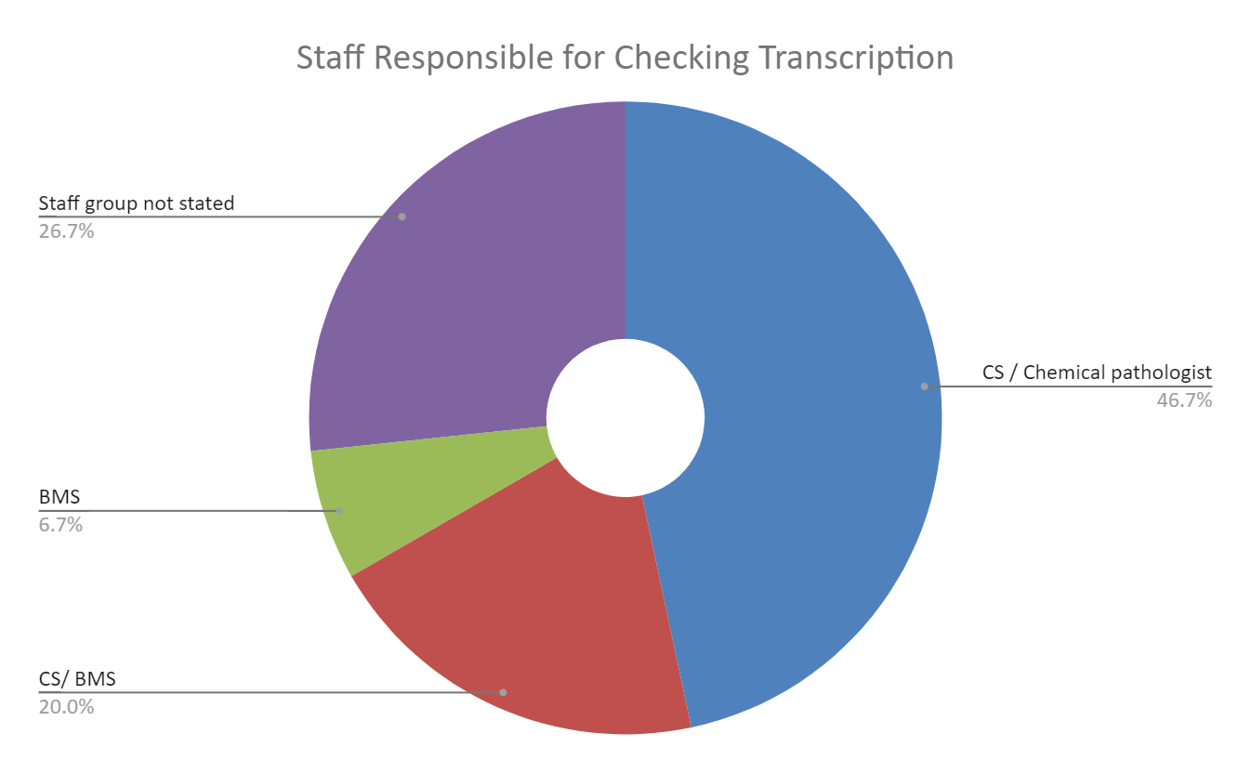
Q29. If results are manually transcribed into your LIMS do you perform a transcription check?
2/17 labs do not perform a transcription check
15/17 labs do perform a transcription check

Slide 40
Q30. Are any results not entered into the LIMS?
12/17 labs stated that some tests are not entered into the LIMS
Genetics tests were given as an example by each of these labs
Other results not entered into the LIMS included:
“Long reports”
AMH
Methotrexate
Maternal serum screening.

Slide 41
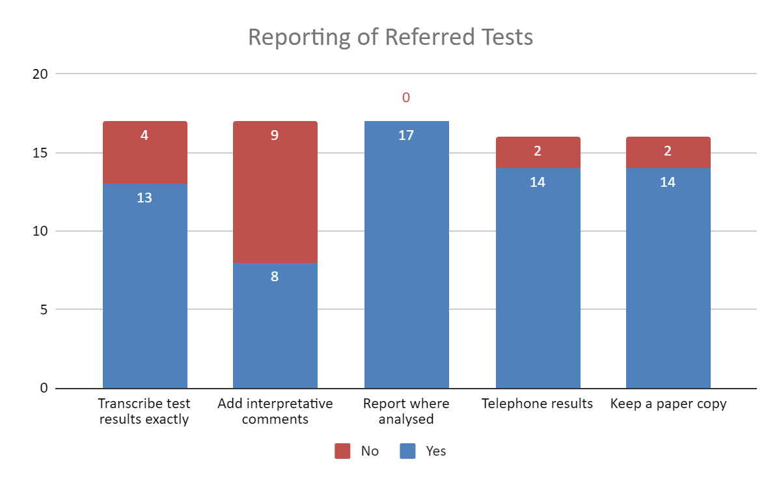
Q31. When reporting externally referred test results do you:

Slide 42
Q31. Continued
Examples of situations where reports are not transcribed exactly as received
When the comment is inappropriate (e.g. patient is being monitored)
Our clinicians have asked us to report the results in a certain way
Reasons given for adding interpretative comments:
Interference testing
Where referral lab does not add a comment (e.g. undetectable ACE)
Examples of phoned referral reports included:
Very high or low Immunosuppressants
Low TPMT, high TGN
Results where same day results have been agreed with clinicians (methotrexate)
Reports phoned through to us by referral lab
A first finding of an IEM or a very high tumour marker
Retention of paper reports varied widely from 2 weeks to 2 years. Several labs scanned reports in and discarded the paper report

Slide 43
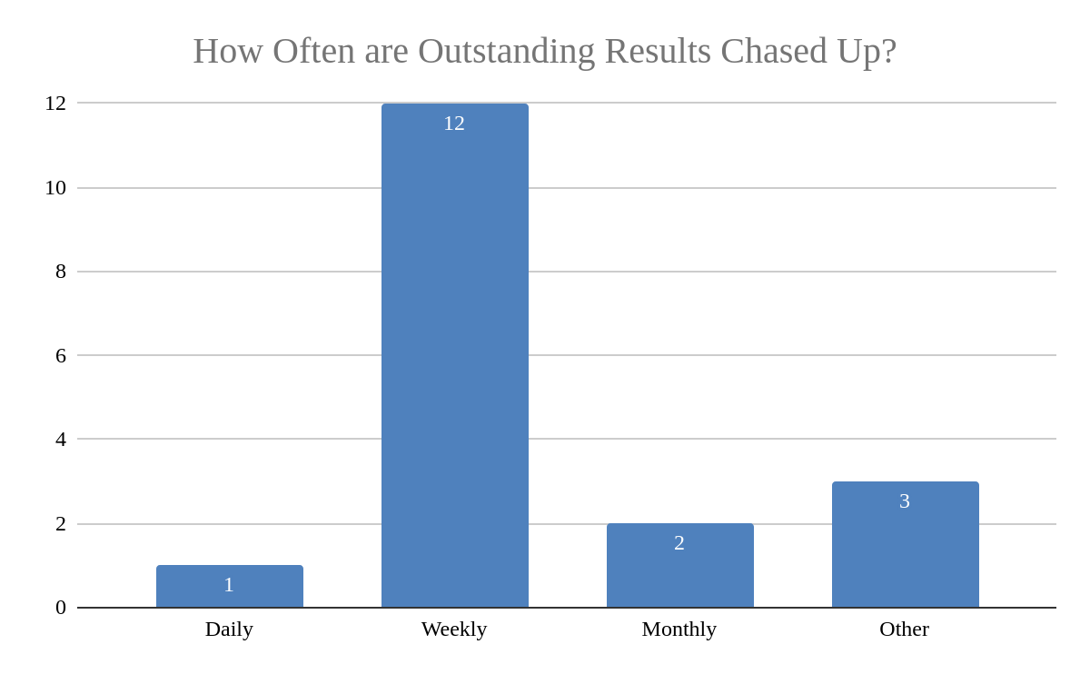
Q33. How often are outstanding results chased up?
Other:
“Only if prompted, there is no procedure in place for identifying overdue results”
“Only if there is a delay or the results are urgent”

Slide 44
Part 6 – Management of Referral Tests
THAMES AUDIT GROUP: Audit of Externally Referred Tests September 2019

Slide 45
Q34/ 35. Do you have SLAs in place with your referral labs? If so who is responsible for drawing them up?
No: 6/17
Yes some: 8/17
Yes all: 3/17
Business relationships manager and quality team
Lab manager
Business office
Assistant service manager
Head BMS
Pathology manager

Slide 46
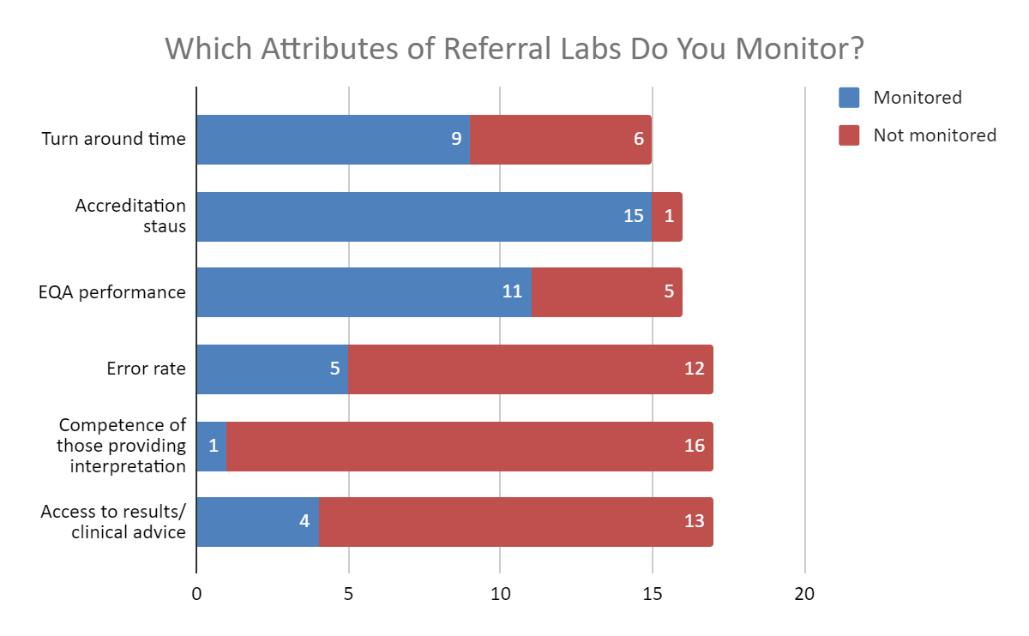
Q36. Which aspects of a referral laboratory do you monitor.

Slide 47
Q37. If you monitor turn around times, what action is taken when they are breached and is there a written policy for this?
9 labs monitored TAT.
None had a written policy for actions to take when TAT was breached.
1 stated that there was currently no detrimental action taken against labs which breached their TAT.
Actions taken: 5 labs would contact the referral lab first then if no improvement would seek another provider

Slide 48
Q38. How often does your lab check the following:
Accreditation status
1/17: Quarterly
13/17: Annually
2/17: Every 2 years
1/17 : No protocol for this
EQA performance
8/17: Annually
4/17: Not checked
2/17: Every 2 years
1/17: Referral lab is expected to contact us if there is a problem
1/17: Only checked if lab is not accredited
Sample requirements for tests
11/17: Annually
2/17: At least every 2 years
1/17: No routine check but changes noted as they come to light

Slide 49
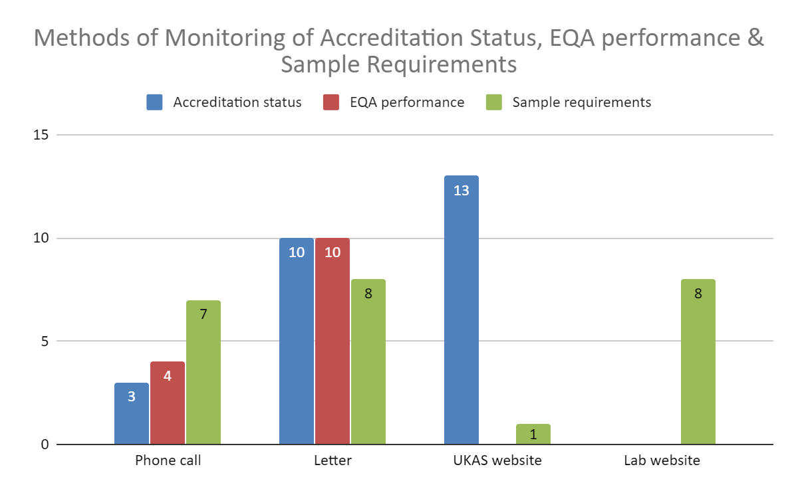
Q39. How does your laboratory obtain information about accreditation status, EQA performance and sample requirements?

Slide 50
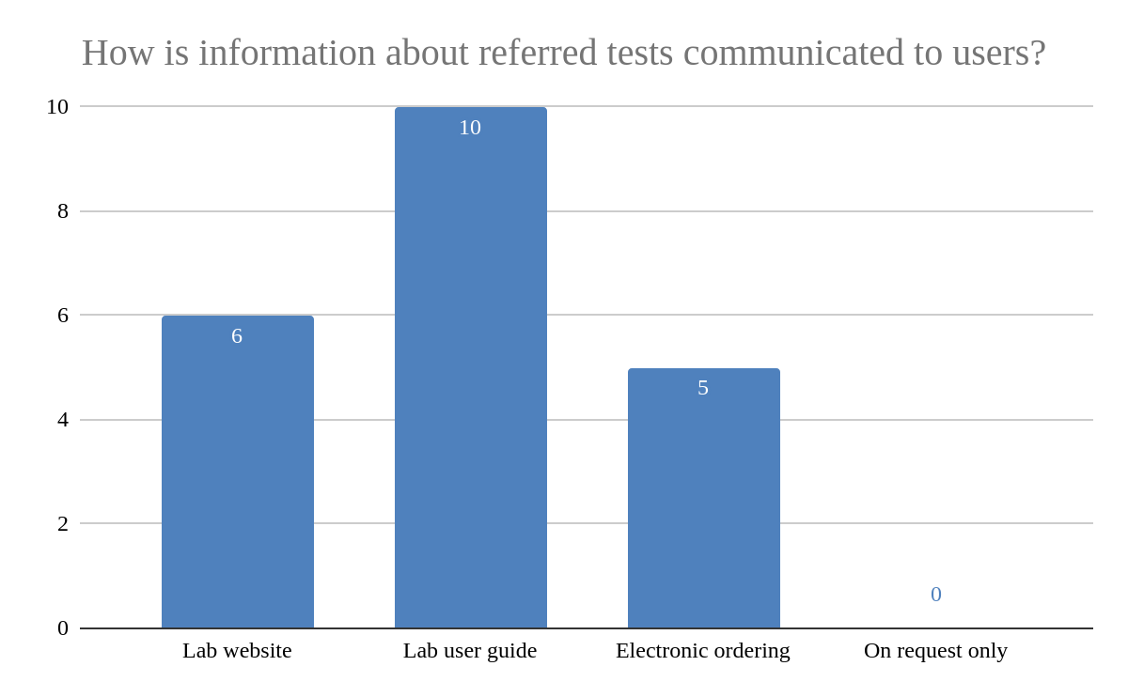
Q40. Do you make information about externally referred tests available to users?
14/15: Yes
1/15: No

Slide 51
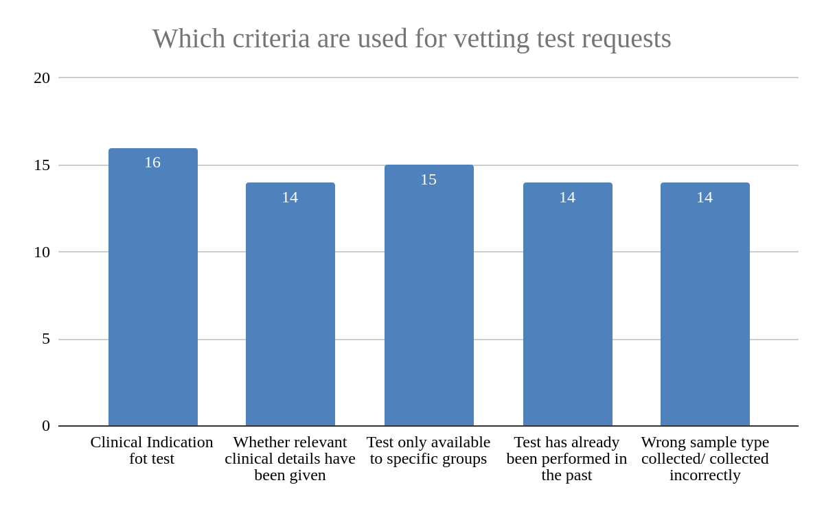
Q41/42. Do you vet any requests for externally referred tests? Which criteria are used?
9/17 labs vet all tests
8/17 labs vet some tests

Slide 52
Q44. Which tests do you most commonly reject requests for?
Other tests mentioned: 17 hydroxy progesterone, 24h urine cortisol, alpha 1 antitrypsin, Amyloid A, ANCA, Bile acids, CA-125, Caeruloplasmin, Calprotectin, Carnitines, CK isoenzymes, free PSA, Fructosamine, GH, Lipase, P3NP, plasma catecholamines, PTHrP, Serum free light chains, SHBG, TPMT, Vitamins B1, B2, B6.

Slide 53
Q43. Do you have any IT processes in place to assist with the vetting of externally referred tests?
6/17: laboratories stated they had some IT processes in place to assist vetting of tests (but from the responses given none have a complete IT solution for this)
Some tests pulled to an authorization queue
Some tests are auto-cancelled (ALP isoenzymes, 1,25 dihydroxy Vitamin D and amylase
LIMS identifies whether TPMT has been requested before. If it has an automatic comment is added.
ALP isoenzymes are not performed unless ALP is more than 1.5X ULN. If this criterion is not met, an automatic comment is added

Slide 54
Part 7 – Referral laboratories only
THAMES AUDIT GROUP: Audit of Externally Referred Tests September 2019

Slide 55
Total number of responses: 16
Non-referral labs: 5
11x labs completed this section as a Referral Lab

Slide 56
Q45. How many specialist tests do you offer to other laboratories? Please give details of the tests/groups of tests offered.
Steroid Hormones by LC-MS/ MS (17OHP, testosterone, 11-deoxycortisol, androstenedione, DHEAS, dihydrotestosterone) Tacrolimus, Cyclosporin A, Trace elements (Zn, Cu, Se), Vitamins A and E, 25OH Vit D2/D3, FIT, 5HIAA & HVA, Urine mets, ACTH, C-peptide, GH, IGF-1, Fructosamine ,Thyroglobulin, Caeruloplasmin, Total bile acids, Serum Free Light Chains
Urine Mets & Cats, Amiodarone & Lamotrigine, Urine citrate & oxalate, Plasma amino acids, Plasma Cats, TDMs
Endocrinology: 30 tests + aldosterone + renin, Bone metabolism: 3, Metabolic: 11, Oncology: 13, Proteins: 14, Trace elements: 13
Endocrinology, biochemical genetics and immunology
1st trimester screening, HIAA, tumour markers, anti-epileptics
Porphyrins
4x tests (not detailed
ACTH, alkaline phosphatase isoenzymes, apolipoprotein A, apolipoprotein B, lipoprotein(a), apolipoprotein E genotyping
ACE (serum), Bile acids (serum), Caeruloplasmin, Copper (serum), Cyclosporin , Cystatin C, GH, IGF-1, Neutrophil gelatinase associated lipocalin (NGAL), Phenobarbitone, Sirolimus, Tacrolimus, Urine 5-HIAA, Urine citrate, Urine free cortisol, Urine magnesium, Urine oxalate
100’s!! We are a specialist referral centre for metabolic & enzymes investigations
Approximately 100 –Porphyrins (SAS service), Gastrointestinal, Steroids (SAS service), Trace elements (SAS service), specialised TDM and DoA service

Slide 57
Q46. How do you provide information to potential referring labs regarding your repertoire of specialist tests and sample requirements? (tick all that apply)
Laboratory website: 7
Assayfinder: 5
Other:
Through local discussions
Assay information sheets
By post
External User Handbook

Slide 58
Q47. Do you provide information to referring labs about the appropriate use of your specialist test(s)?
Yes: 6
No: 5
If yes, please give details of how this information is provided
Website gives details on clinical indication for test and sample requirements
Lab handbook
On reports
Leaflet

Slide 59
Q48. How many forms of matching ID are required for accepting samples at your referral laboratory? Please state which points of ID are mandatory for accepting a sample.
All labs state minimum of 3x points of ID
name (first name AND surname required)
date of birth
MRN
NHS number
referring lab number
referral hospital number

Slide 60
Q49. Do you input the patient’s NHS number into your pathology system when registering receipt of an externally referred specimen?
Yes : 10
No : 1
“Our system does not allow us to enter an NHS number unless we use the NHS Spine. Many request forms do not provide an NHS number, but if available, some sections of our lab can use the NHS Spine to positively identify patients when enough information is available on the request form but this is not our routine process.”

Slide 61
Q50. Do you use the NHS spine when registering external patient specimens into your laboratory system?
Yes: 4
No: 7
“NHS spine is used where there is insufficient information on the form e.g. surgery details or physician details”

Slide 62
Q51. How do you avoid multiple registrations of external patients in your laboratory system? (e.g. slight name changes/differences in the spelling).
“Previous entries checked in LIMS system. Prev sample saved using old lab number as hospital number”
“Request is searched on LIMS using patient name and the same record is used if there is a match with the same DOB/NHS number. If there is any uncertainty, then a new patient record is created”
“Merged subsequently as and when found”
“Patient indexed system”
“Nothing in place currently”
“Its really difficult! Our LIMS system first looks up a patient name with forename/surname/gender but not date of birth! If we have slight name changes/difference in spelling and no NHS no., then we have no choice but to create a registration with the details as on the request form.”
“Potential duplicates monitored by the Health Information Management team. Spine compliant LIMS”
“Using NHS number or Hospital number as the primary ID, any anomalies are investigated”
“Difficult, system not equipped”

Slide 63
Q52. Do you vet any requests from referring labs for appropriateness of the request?
Yes : 2
No : 9
If yes, please give details
Provide appropriate tests if clinical information provided
If apolipoprotein E genotyping has been done before, it will not be repeated

Slide 64
Q53. If a referring laboratory does not provide clinical information, does this have an impact on the quality of your analytical report, e.g. whether or not interpretative comments are added?
Yes : 7
No : 4
If yes, please give details
Potential impact on quality of interpretive comment

Slide 65
“Where clinical interpretation is added to our reports, we comment as best we can with interpreting the results with the information we have. We describe the abnormalities, listing the most relevant/clinically important findings first, and offering possible causes, diagnosis and/or differential diagnosis with reference to any detail we do have (e.g. referring hospital, ward location, specialty etc). We recommend further tests when relevant. In the cases of diagnostically urgent results, we would contact the referring hospital to discuss the results, clinical information if available and discuss the diagnosis/further urgent tests to confirm/exclude a diagnosis”
“may affect its interpretation. Good example of this is aldosterone and renin interpretation, it is useful to know any drugs the patient may be on etc. Also very useful for insulin, C-peptide and steroid panels (testosterone, androstenedione and 17-OHP).”
“Unnecessary tests are provided”

Slide 66
Q54. How does your laboratory report results to referring laboratories? Please tick all that apply.
Most labs use more than one method
Post : 10
Email : 7 (1x on request only)
Fax : 3
NPEx : 1
Other electronic referrals system. Please give details:
Cyberlab/ WinPath electronic referrals
ICM/DART
Online results portal
1x lab post only
1x lab ICAM/DART only

Slide 67
Q55. Do you have Service Level Agreements in place with your referring labs?
Yes – all: 1
Yes – some : 5
No: 5

Slide 68
Q56. Does your lab contact your referring laboratories to inform them of changes to your service in the following situations:
If yes to any of the above, please give details of how you contact the referring laboratories:
Post/email
Automated comments appended to reports, email to a designated contact at a referring laboratory
On lab reports

Slide 69
Q57. If your lab receives clinically urgent samples, how do you ensure the referring laboratory is aware of the urgency of delivering the specimens?
“Usually we are made aware of urgent investigations of external patients through our clinical teams who have had contact with the local clinical team. They would normally advise on which tests to perform but often do not express how urgent they are. The local team then do not inform their local lab of the urgency of these tests and there is often a delay in sending the samples to us. We endeavour to liaise with the local lab/duty biochemist once we have been informed by our clinicians that we are to expect urgent samples, but this is not always possible. The duty biochemist will chase up expectant urgent samples from the referring hospital either directly with the lab or through our clinical teams”
“Communication with Specimen Reception and then bench for testing”
“Sample requirements are available on the laboratory handbook / website”
“Specified on assay information sheet”
“The urgent nature of the test is first called to the duty biochemist who will vet the request and may forward the caller onto a senior scientist in that laboratory to discuss logistics.”

Slide 70
Part 7 - Summary & Points to consider
Variable sources of assay information
departmental websites/ Assayfinder/handbook
Variable information available on the clinical utility of tests/guidance on appropriate requesting
Only 6/11 labs providing this on their website/handbook
Lack of NHS number on request forms can cause multiple patient registrations in LIMS. Very limited use of NHS Spine.
Lack of clinical information on the request form can impact quality of interpretative comments appended to report
Most popular reporting mechanism is POST! Very little use of e-mail/NPex/Online reporting
Very few labs inform service users of changes in lab service (UKAS accreditation, EQA performance, delays)
ALL however report changes in method/reference ranges/specimen type)

